Slide 1

REST APIs - Authentication and Authorization
Programming Applications And Frameworks (It3030)

Slide 2
Learning outcomes
After completing this lecture, you will be able to,
Know the difference between authentication and authorization.
Apply different authentication and authorization mechanisms for REST APIs as appropriate to given scenarios.

Slide 3
Contents
Authentication vs. Authorization
Importance of Authentication and Authorization
Some methods for Authentication and Authorization in REST APIs
HTTP Basic Authentication
API Keys
JSON Web Tokens (JWT)
OAuth 2.0
OpenID Connect (OIDC)
Summary

Slide 4
Authentication vs. Authorization
Should everyone have free access to your resources?
No! Only known users should.
How do we identify if a user is a known user?
Authentication!
[YouTube] Session vs Token Authentication

Slide 5
Authentication vs. Authorization
Should all known users be allowed to access all resources?
No! They should only have access to what we explicitly want them to access.
How do we control what they can access?
Authorization!

Slide 6
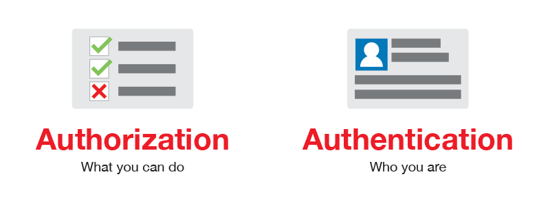
Authentication vs. Authorization
Source: https://blog.restcase.com/4-most-used-rest-api-authentication-methods/

Slide 7
Authentication vs. Authorization
Authentication is when an entity proves an identity.
Authentication proves that you are who you say you are.
Authorization is when an entity proves a right to access.
Authorization proves you have the right to make a request.
In summary:
Authentication: Refers to proving correct identity.
Authorization: Refers to allowing a certain action.
Notes:
e.g.: Authentication: SLIIT ID issued to you by SLIIT. Proves you are who you claim to be.
Authorization: What rights/ permissions have been granted to you with the ID?

Slide 8
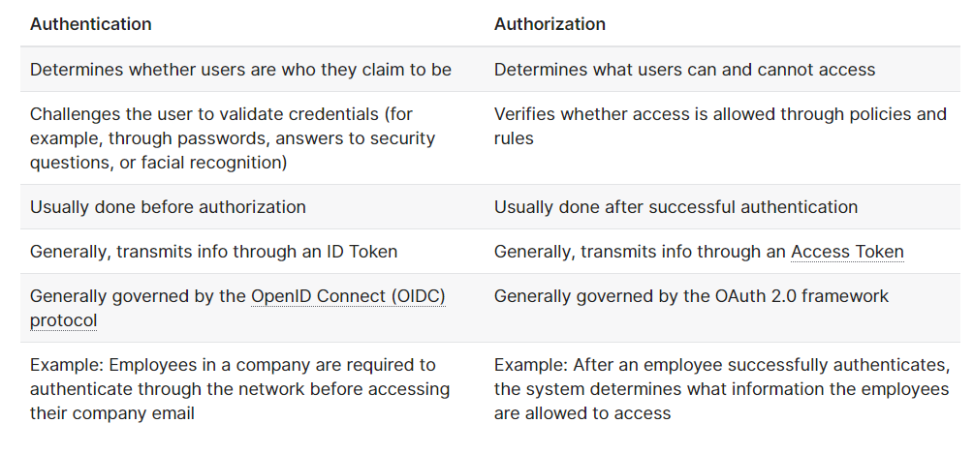
Authentication vs. Authorization
Source: https://auth0.com/docs/get-started/identity-fundamentals/authentication-and-authorization

Slide 9

Some methods for AUTH in REST APIs
HTTP Basic Authentication
API Keys
JSON Web Tokens (JWT)
OAuth 2.0
OpenID Connect (OIDC)

Slide 10
HTTP Basic Authentication
Most basic form of authentication in APIs.
The client sends the username and the password of the user encoded in Base64 encoding technique to the server.
The credentials are sent in the HTTP header with every request.
Authorization: Basic <username:password>

Slide 11
HTTP Basic Authentication
Very simple to use as it does not require cookies, session identifiers, login pages.
Lightweight.
Good for use-cases like IoT.
Rarely recommended due to its inherent security vulnerabilities.
For better security use with HTTPS over SSL/ TLS.

Slide 12
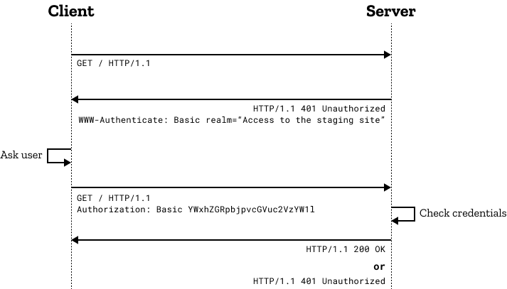
HTTP Basic Authentication
Source: https://developer.mozilla.org/en-US/docs/Web/HTTP/Authentication

Slide 13
API Keys
A unique generated key value is assigned for each first-time user.
Thereafter, the user sends all requests with the key as
a query parameter or
in the HTTP header (the standard way)
Simple, fast and convenient.

Slide 14
API Keys
A method of authentication, not authorization.
No expiration.
Once the key is stolen, it may be used indefinitely unless revoked.
As with Basic HTTP authentication, not recommended to be used as is.
For better security use with HTTPS over SSL/ TLS.

Slide 15
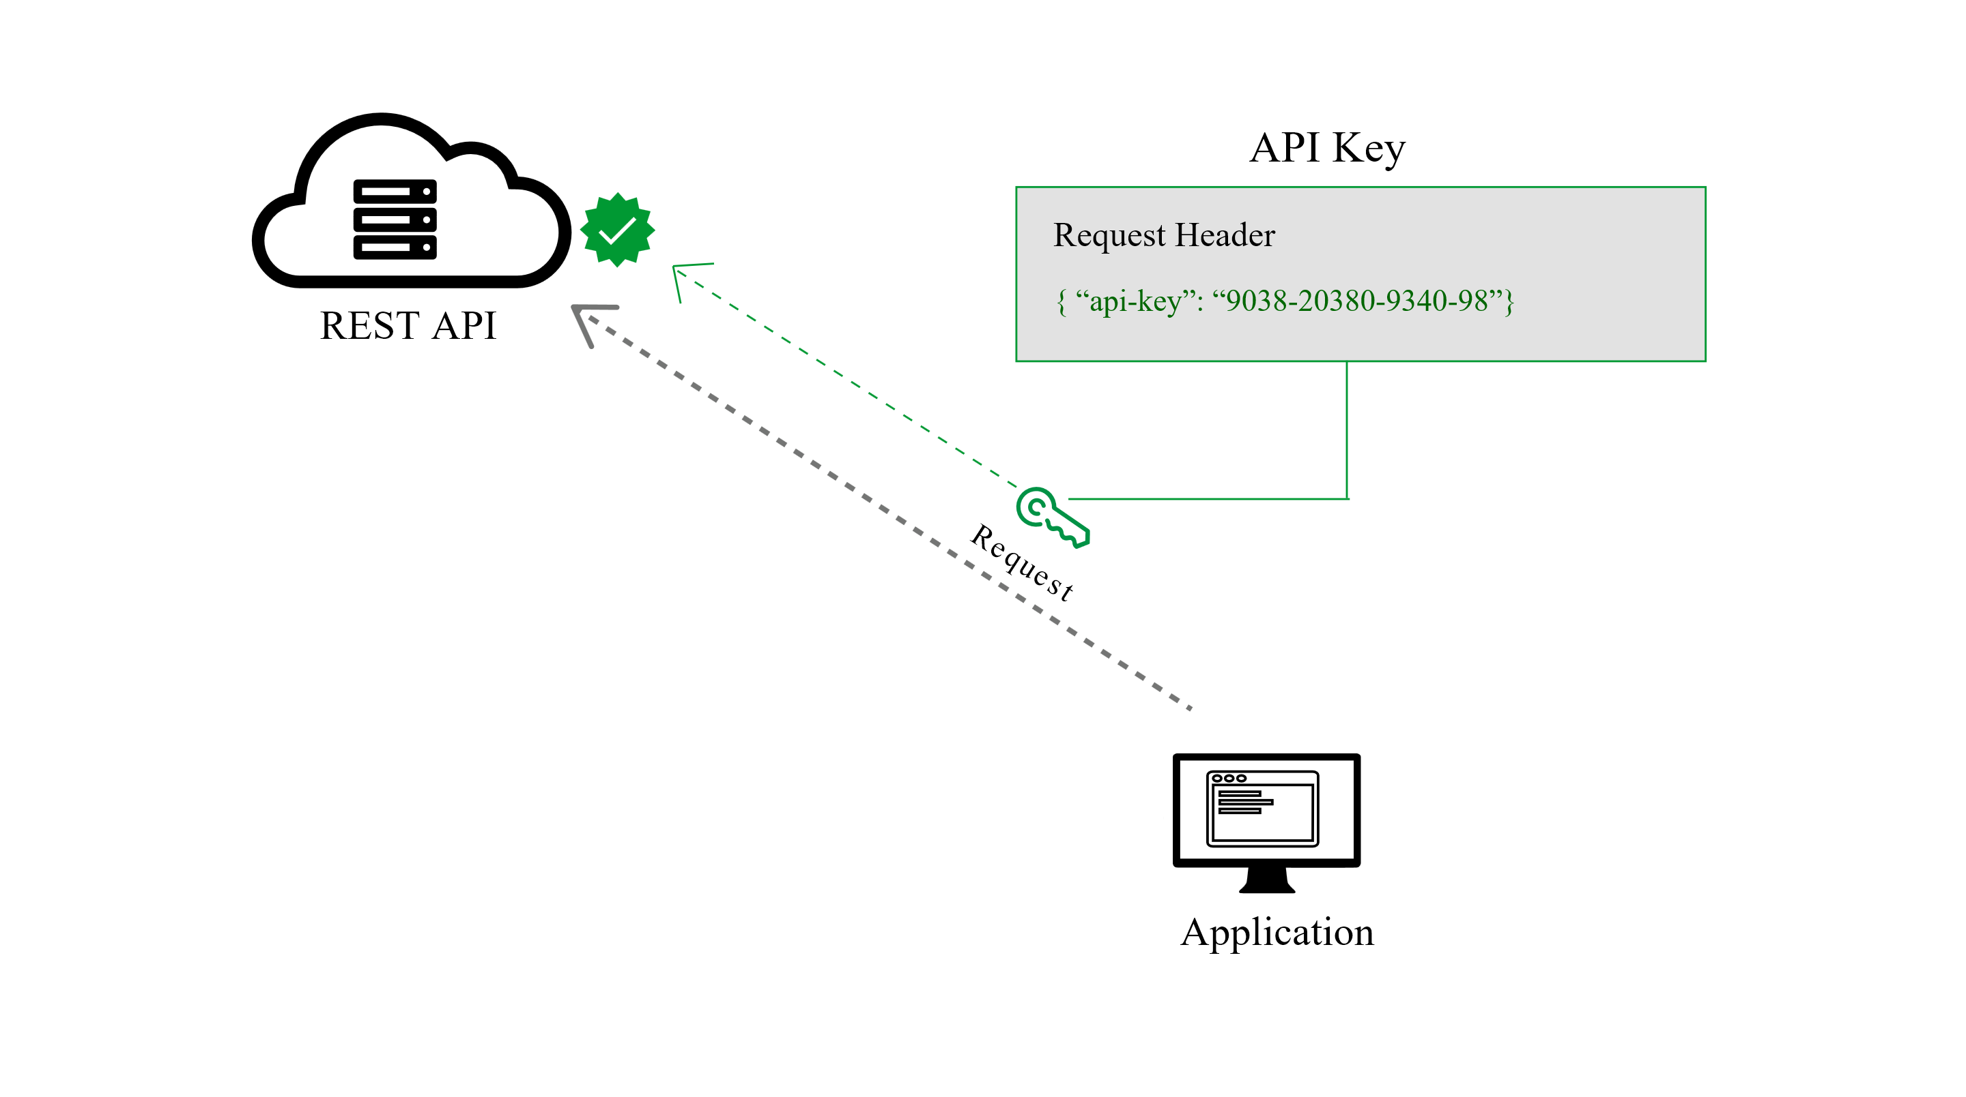
API Keys
Source: https://blog.restcase.com/4-most-used-rest-api-authentication-methods/

Slide 16
JSON Web Tokens (JWT)
A compact and a self-contained means to securely exchange information between parties as a JSON object.
Digitally signed, therefore can be verified and trusted.
Using secrets
Using public/ private key pairs
Used for user authorization after authentication.
Very popular!

Slide 17
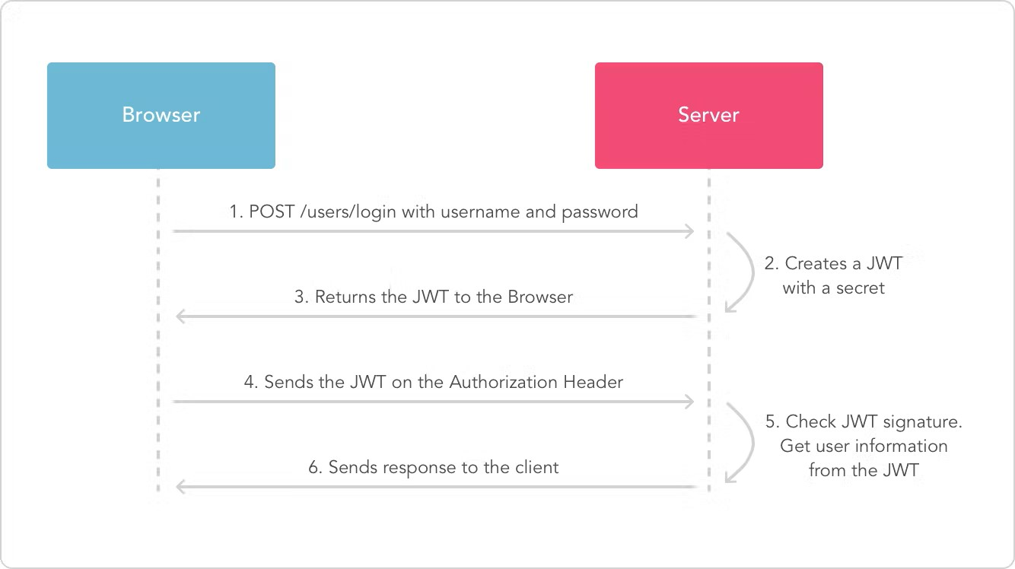
JSON Web Tokens (JWT)
Request HTTP Header: Authorization: Bearer <token>
Source: https://lo-victoria.com/introduction-to-rest-api-authentication-methods

Slide 18
JSON Web Tokens (JWT)
JWT Decoder – example JWT demo
JWT guarantees that data is not tampered because of the signature.
The contents of a JWT can be seen by anyone that intercepts the token.
It is just serialized, not encrypted.
It is recommended to use HTTPS to avoid this problem.
JWT is pronounced as “Jot”.
JWT is good for implementing stateless APIs.

Slide 19
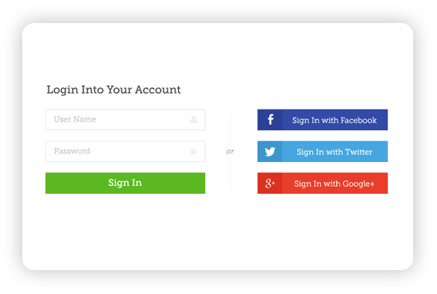
Oauth 2.0
Have you seen this before?
Source: https://lo-victoria.com/introduction-to-rest-api-authentication-methods

Slide 20
OAuth 2.0
It is an authorization framework/ protocol.
If an implementation also conforms to OpenID Connect specification, it will also support authentication.
This is how social authentication works!
OAuth works by,
Delegating user authentication to a service that hosts a user account
Authorizing third-party applications to access that user account

Slide 21
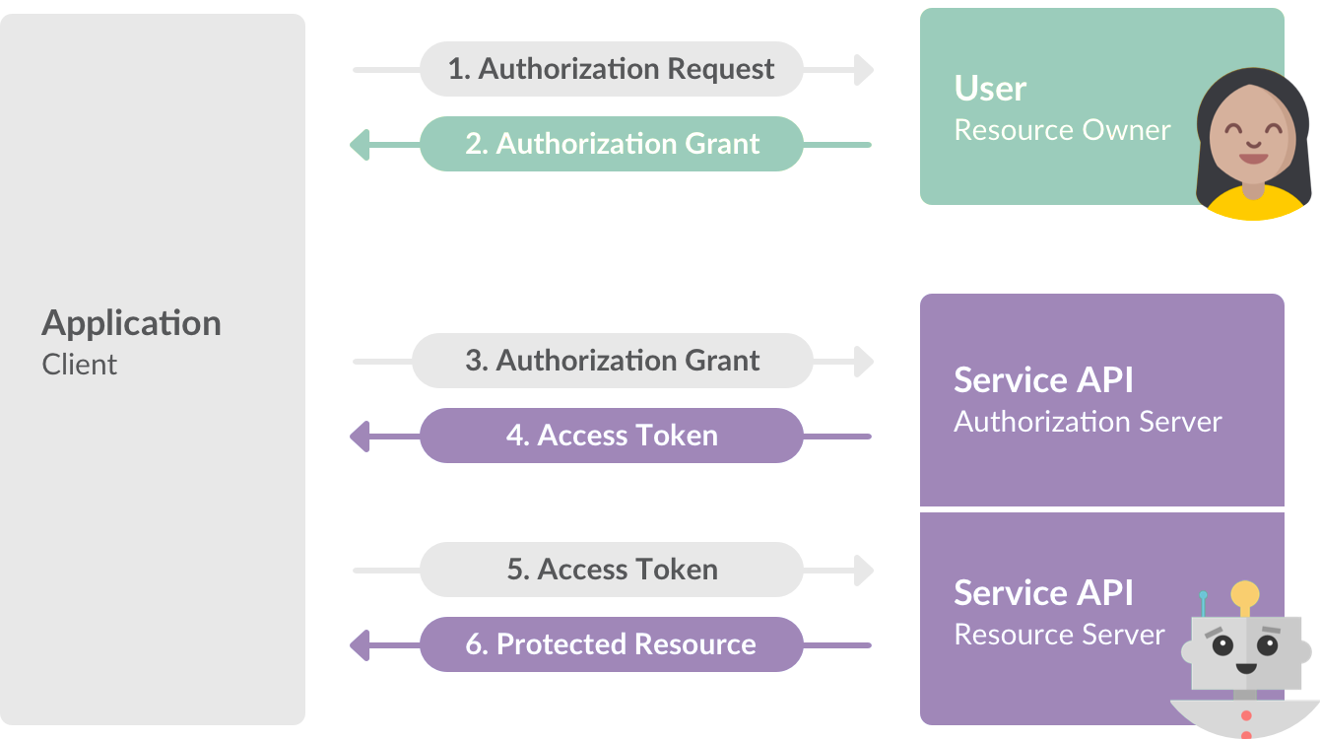
OAuth 2.0
Client Identity info
+
Source: https://lo-victoria.com/introduction-to-rest-api-authentication-methods

Slide 22
OAuth 2.0
OAuth Roles
Resource Owner: The resource owner is the user who authorizes an application to access their account.
Client: The client is the application that wants to access the user’s account.
Authorization Server: The authorization server verifies the identity of the user then issues access tokens to the client application.
Resource Server: The resource server hosts the protected resources.

Slide 23
Oauth 2.0
An OAuth 2.0 flow (grant type) is a way of retrieving an Access Token.
OAuth 2.0 supports different authorization flows (also known as grant types).
Authorization Code Flow – Widely used for server-side and mobile web applications.
PKCE
Client Credentials flow etc.

Slide 24
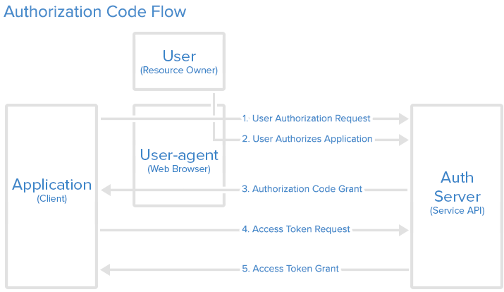
Oauth 2.0
Authorization Code Flow
Source: https://www.digitalocean.com/community/tutorials/an-introduction-to-oauth-2

Slide 25
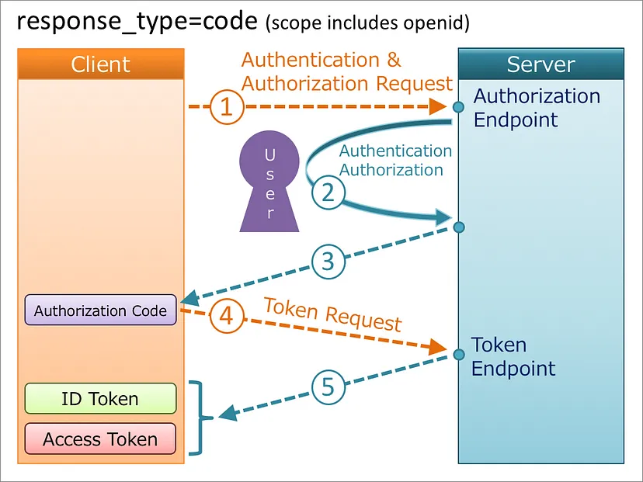
OpenID Connect
Authorization Code Flow + with Authentication
Source: https://darutk.medium.com/diagrams-of-all-the-openid-connect-flows-6968e3990660

Slide 26
Oauth 2.0
Why use OAuth 2.0?
It enables an application to obtain limited access (scopes) to a user’s data without the user having to share their password.
Why use OpenID Connect (which is an extension of OAuth 2.0)?
Accelerate Sign Up Process at Your Favorite Websites
No need to maintain multiple usernames/ passwords.
Minimize password security risks.

Slide 27
Oauth 2.0
[YouTube] OAuth 2.0: An Overview

Slide 28
Self-Study activity
There is much more in OAuth 2.0.
Read this introduction to OAuth 2.0 to get a more detailed understanding.
Spring Boot and OAuth 2.0
Check out these official tutorials from Spring.

Slide 29
Summary
Authentication vs. Authorization
Importance of Authentication and Authorization
Some methods for Authentication and Authorization in REST APIs
HTTP Basic Authentication
API Keys
JSON Web Tokens (JWT)
OAuth 2.0
OpenID Connect (OIDC)

Slide 30
References
3 Common Methods of API Authentication Explained
4 Most Used REST API Authentication Methods
How does HTTPS actually work?
HTTP authentication
API Keys
Introduction to JSON Web Tokens
Authorization Code Flow

Slide 31

Thank You
Vishan.j@sliit.lk
nelum.a@sliit.lk

